Slide 1
Science Understanding
- light exhibits many wave properties; however, it cannot only be modelled as a mechanical wave because it can travel through a vacuum
TRACK WITH ME
READ WITH ME
Identify the wave properties of light
  explain the difference between transverse and longitudinal waves.
  explain the difference between mechanical and electromagnetic waves.
  identify the key characteristics of waves.
  explain reflection, refraction, diffraction and dispersion.
  define polarisation and draw a diagram explaining how Polaroid sunglasses work.
Theorise why light can travel through a vacuum
Notes:
Learning Objectives contain concepts (nouns, big ideas), skills (verbs, measurable behaviours) and sometimes context (restricting or targeting conditions).
●Example: Students will be able to describe the concept of density and apply it to floating and sinking.
●
Success criteria are specific measurable outcomes that if met mean that the student has met the learning objective.
Examples:
•Students will be able to compare densities of substances using mass and volume.
•Students will be able to identify whether a solid or liquid will float or sink in a liquid based on their densities.

Slide 2
Additional Syllabus Points:
Scientific Understanding
a wave model explains a wide range of light-related phenomena, including reflection, refraction, dispersion, diffraction and interference; a transverse wave model is required to explain polarisation
electromagnetic waves are transverse waves made up of mutually perpendicular, oscillating electric and magnetic fields
oscillating charges produce electromagnetic waves of the same frequency as the oscillation; electromagnetic waves cause charges to oscillate at the frequency of the wave

Slide 3

Identify the wave properties of light

Slide 4
Identify the wave properties of light
List as many properties of 2D waves that you can
remember from Year 11.
Transfer of energy (no/little matter)
  Particles in medium vibrate about their mean positions
  Particles experience no permanent displacement
  Successive particles perform similar motions with slight time delay
Draw a diagram and label the other properties…
Include: amplitude, wavelength, peak, direction of motion
CHECK FOR UNDERSTANDING
What are some real life examples of these properties?

Slide 5
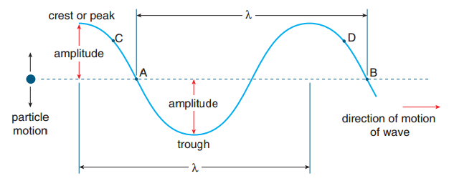
Identify the wave properties of light
CHECK FOR UNDERSTANDING
What are some real life examples of these properties?

Slide 6
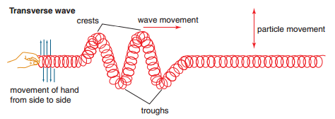
Identify the wave properties of light
Transverse Waves:
Waves have oscillations that are perpendicular to the direction the wave is traveling.
Example: Electromagnetic waves are all transverse
CHECK FOR UNDERSTANDING
What are some other real life examples of transverse waves?

Slide 7
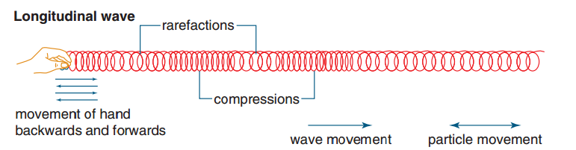
Identify the wave properties of light
Longitudinal Waves:
Waves have oscillations that are parallel to the direction of propagation
Example: sound waves
CHECK FOR UNDERSTANDING
What are some real life examples of longitudinal waves?

Slide 8
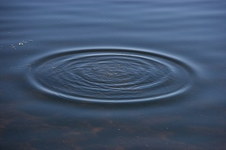
Identify the wave properties of light
Mechanical Waves:
Waves propagate through a medium (e.g. water, spring, air). They require a medium to carry them – that means they cannot transmit energy through a vacuum.
Examples of mechanical waves are sound
waves, water waves and Mexican waves.
CHECK FOR UNDERSTANDING
Are mechanical waves transverse or longitudinal?

Slide 9
Identify the wave properties of light
CHECK FOR UNDERSTANDING
Are electromagnetic waves transverse or longitudinal?
Electromagnetic Waves
Waves produced by the vibration of charged particles. They consist of periodic oscillations of electric and magnetic fields generated by charged particles.
Examples radio waves, microwaves, infrared radiation, visible light and X-rays. Basically anything that makes up the Electromagnetic Spectrum.
Electromagnetic waves can travel with or without a medium. The medium determines the speed.
The speed of light is not always the same! However, the speed of light through a vacuum is constant.

Slide 10
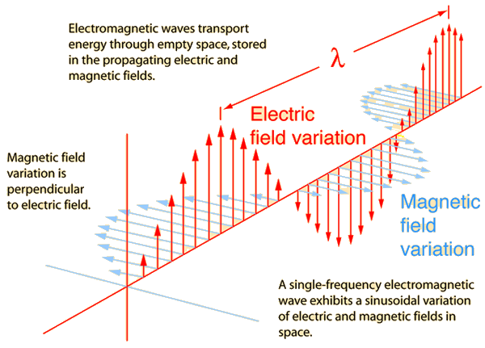
Identify the wave properties of light
CHECK FOR UNDERSTANDING
Why is the magnetic and electric variation at right angles?

Slide 11
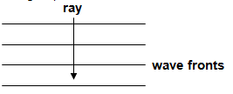
Identify the wave properties of light
Wave Fronts:
A wave front represents all particles in the medium which are in the same phase
All the crests (or troughs) or all the compressions (or rarefactions).
A ray is a line drawn perpendicular to the wave fronts showing the direction of propagation. Each successive wave front is a wavelength apart.
CHECK FOR UNDERSTANDING
Why is the magnetic and electric variation at right angles?

Slide 12
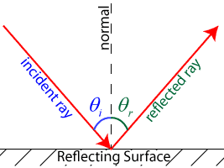
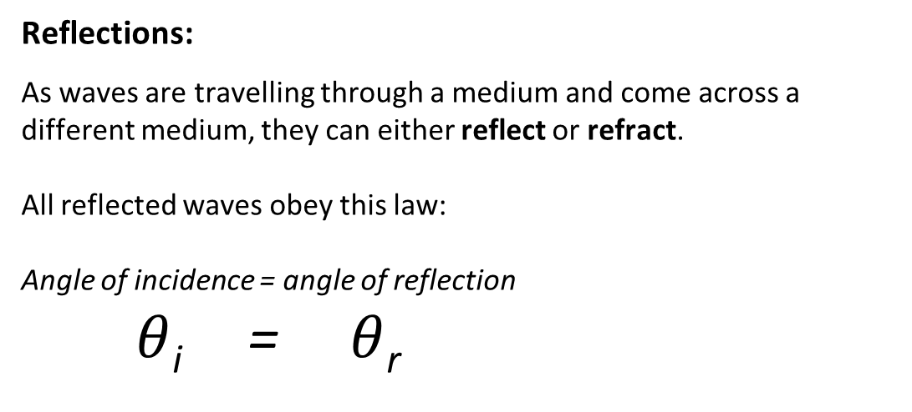
Identify the wave properties of light
CHECK FOR UNDERSTANDING
What should you always include when drawing a reflected wave?
Reflections:
As waves are travelling through a medium and come across a different medium, they can either reflect or refract.
All reflected waves obey this law:
Angle of incidence = angle of reflection
$θ$_{i} = $θ$_{r}

Slide 13
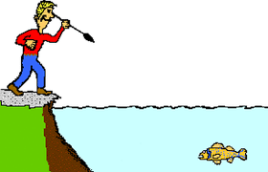
Identify the wave properties of light
CHECK FOR UNDERSTANDING
What should you always include when drawing a reflected wave?
Real life scenario…..kinda
Jill really likes spear fishing but she can’t quite seem to catch any…..
Why do you think she is having trouble?
(hint: physics is the answer to everything)

Slide 14
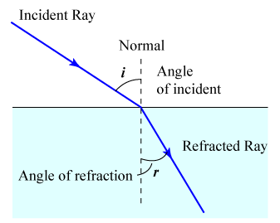
CHECK FOR UNDERSTANDING
What would happen if a incident wave hits the surface at 90º ?
Identify the wave properties of light
Refraction:
As waves are travelling through a medium and come across a different medium, they can either reflect or refract.
Refracted waves change direction, speed (velocity) and wavelength when the medium changes.
FREQUENCY OF WAVES ARE CONSTANT
Wave increases speed | Wave decreases speed
Bends away from the normal | Bends towards the normal

Slide 15
CHECK FOR UNDERSTANDING
Predict what you thinking will happen
Identify the wave properties of light
AIR
GLASS
AIR

Slide 16
CHECK FOR UNDERSTANDING
Predict what you thinking will happen
Identify the wave properties of light
N
AIR
GLASS
AIR
N

Slide 17
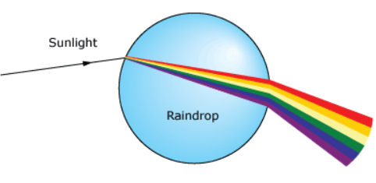
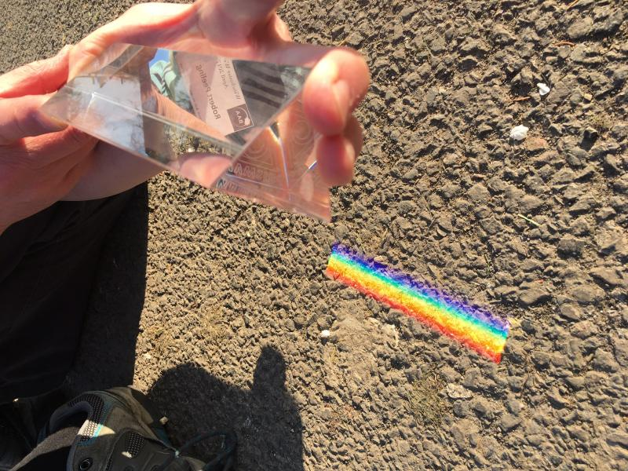
CHECK FOR UNDERSTANDING
Can you think of any other examples of dispersion?
Identify the wave properties of light
Dispersion:
The spreading out of EM waves (particularly light waves) when refracted by a medium.
A common example is sunlight refracted by a raindrop or glass prism

Slide 18
CHECK FOR UNDERSTANDING
What are the colours of the rainbow?
Identify the wave properties of light
Dispersion:
The spreading out of EM waves (particularly light waves) when refracted by a medium.
ROYGBIV
Sunlight is a range of EM waves ranging from red light waves to violet light waves.
These EM waves travel through a raindrop at slightly different speeds depending on their frequency. Lower frequency red light waves travel faster than higher frequency violet light waves.
The result is a range of refraction angles – the light is dispersed. This dispersed light is referred to as a spectrum.

Slide 19
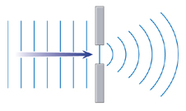
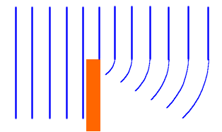
CHECK FOR UNDERSTANDING
Why do you need to understand diffraction as a spy? Who is a better spy? Miss Alex or you?
Identify the wave properties of light
Diffraction:
Bending of waves as they pass through an opening or around the edge or edges of an obstacle.
If the wavelength is approximately the same length as the opening then maximum diffraction will occur.
When waves are
diffracted, the speed,
wavelength and
frequency of the wave
DOES NOT CHANGE.
Higher frequency sound waves have shorter wavelengths so they will diffract less than lower frequency sound waves as lower frequency sound waves have longer wavelengths.

Slide 20
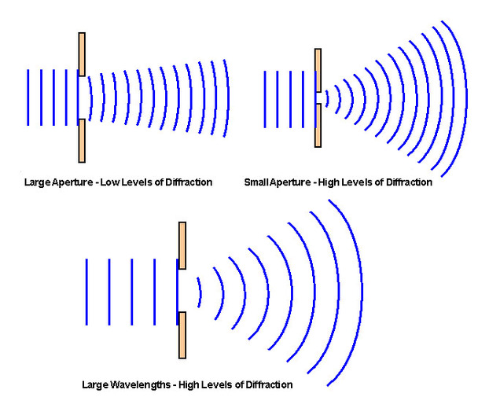
Identify the wave properties of light
Diffraction:

Slide 21
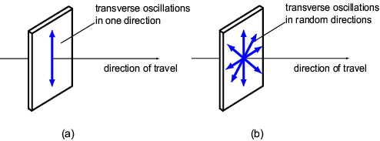
CHECK FOR UNDERSTANDING
What industry profits off polarisation? Use the image to describe the benefits of polarisation.
Identify the wave properties of light
Polarisation:
Firstly, light is a transverse wave. That means it oscillates ‘up’ and ‘down’, rather than ‘forward’ and ‘back’.
Polarisation is the process of transforming unpolarised light into polarised light.
Light is considered
polarised if the light
waves occur in a single
plane. In the diagram
below (a) represents
polarised light and (b)
represents unpolarised light.

Slide 22
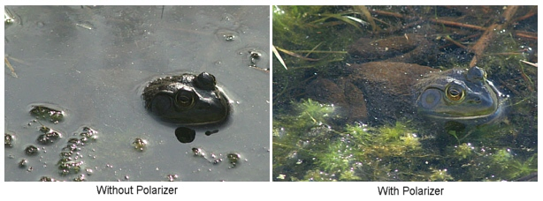
CHECK FOR UNDERSTANDING
Which image was taken with a polariser?
Identify the wave properties of light
Polarisation:
Polarisers can allow us to photograph what happens underwater. This is because that light coming off the surface of a body of water is unpolarised, yet the light coming off the objects under the water is polarised. The polariser will block out the unpolarised light, letting us see what
is underneath.

Slide 23
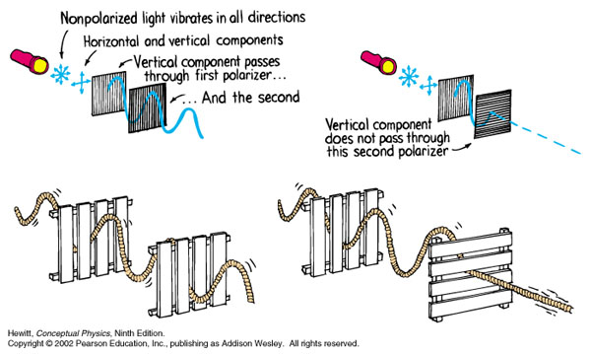
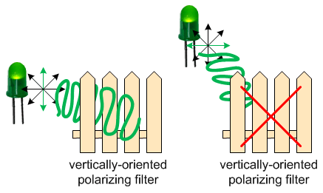
CHECK FOR UNDERSTANDING
Would this analogy apply to visible light?
Identify the wave properties of light
Polarisation:
Picket fence analogy

Slide 24
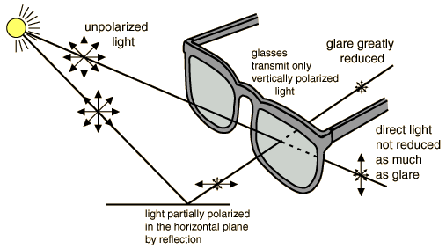
CHECK FOR UNDERSTANDING
Should you use polaroid sunnies when you drive?
Identify the wave properties of light
Polarisation:
Now what you’ve all been waiting for…….
SUNNIES!!
Polaroid sunglasses use
polarisation to reduce
glare. Reflected, polarised
light is allowed to pass, but
unpolarised light does not.

Slide 25
CHECK FOR UNDERSTANDING
Fist to five for all points
Identify the wave properties of light
Review
Reflection is caused by a change in direction as a wave strikes a boundary. The velocity, wavelength and frequency of the wavelength does not change. The direction of the wavelength changes. Applications of reflections include echoes and reverberation.
Refraction is caused by a change in speed of a wave as a result of a change in density of a medium. The frequency remains unchanged, but the wavelength, velocity and direction changes. Importantly this means that the colour of visible light will not change as it changes medium as the frequency remains unchanged.
Diffraction is caused by a change in direction as a result of a wave passing through a gap or around an edge. The velocity, frequency and wavelength of the wave do not change, but the direction changes. This is how we can hear around corners and through doorways.
Polarisation is the process of transforming unpolarised light into polarised light. Light is considered polarised if the light waves occur in a single plane
Polaroid sunglasses reduce glare by blocking unpolarised light.

Slide 26
Science Understanding
- light exhibits many wave properties; however, it cannot only be modelled as a mechanical wave because it can travel through a vacuum
TRACK WITH ME
READ WITH ME
Identify the wave properties of light
  explain the difference between transverse and longitudinal waves.
  explain the difference between mechanical and electromagnetic waves.
  identify the key characteristics of waves.
  explain reflection, refraction, diffraction and dispersion.
  define polarisation and draw a diagram explaining how Polaroid sunglasses work.
Theorise why light can travel through a vacuum
Notes:
Learning Objectives contain concepts (nouns, big ideas), skills (verbs, measurable behaviours) and sometimes context (restricting or targeting conditions).
●Example: Students will be able to describe the concept of density and apply it to floating and sinking.
●
Success criteria are specific measurable outcomes that if met mean that the student has met the learning objective.
Examples:
•Students will be able to compare densities of substances using mass and volume.
•Students will be able to identify whether a solid or liquid will float or sink in a liquid based on their densities.

